Slide 1

Helmet Detection
Using CNN and Kaggle Dataset
DESIGNED FOR YOU

Slide 2
Introduction
This presentation explores helmet detection using a Convolutional Neural Network (CNN) trained on a Kaggle dataset. It covers model development, challenges, and performance evaluation for improving safety through automated detection.

Slide 3

01
Helmet Detection Overview

Slide 4
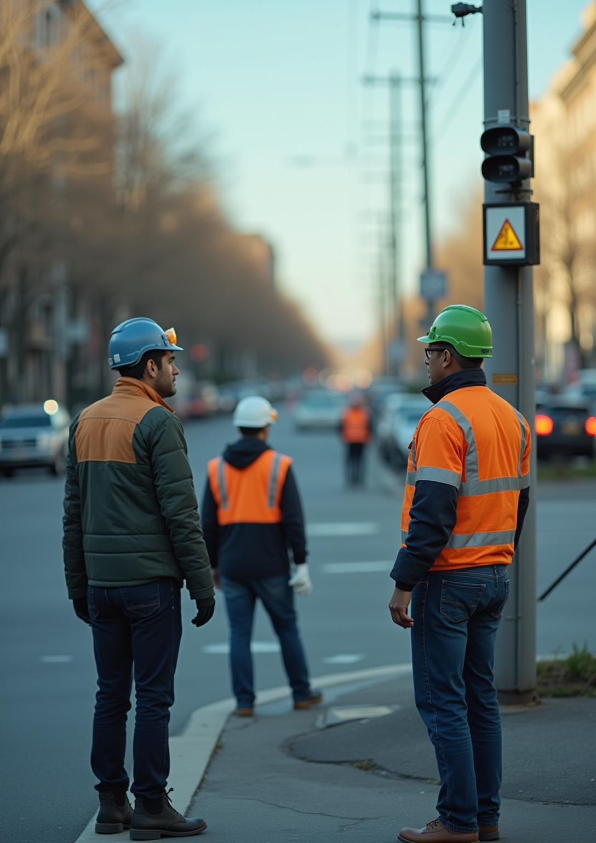
Importance of helmet detection in safety
Helmet detection enhances workplace and road safety by ensuring compliance with safety regulations. Automated detection systems help reduce accidents and injuries by identifying individuals not wearing helmets in real time.

Slide 5
Challenges in helmet detection
Challenges include varied helmet designs, complex backgrounds, and poor lighting. Differentiating helmets from other objects and addressing occlusions in images can reduce detection accuracy and require robust CNN models.

Slide 6
Role of CNN in image recognition
Convolutional Neural Networks (CNNs) excel at recognizing patterns in images. They automatically extract features like edges and shapes, making them ideal for helmet detection in varied environments with high accuracy.

Slide 7
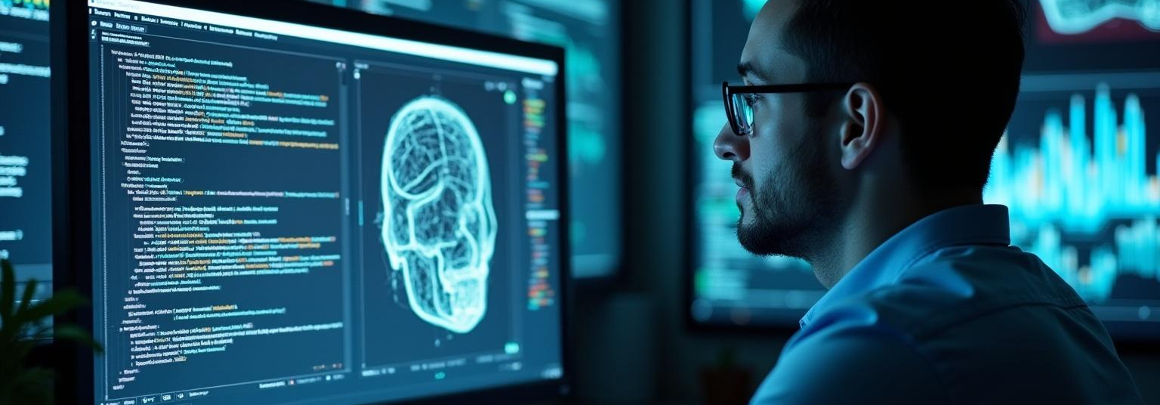
02
CNN Model Development and Application

Slide 8
Dataset from Kaggle description and preprocessing
The Kaggle dataset contains labeled images of people with and without helmets. Preprocessing includes resizing, normalization, and data augmentation to improve model robustness and prevent overfitting.

Slide 9

CNN architecture and training process
A multi-layer CNN was designed with convolutional, pooling, and dense layers. The model was trained using cross-entropy loss and optimized with Adam for several epochs, achieving effective feature learning.

Slide 10
Evaluation metrics and model performance
Model performance was assessed using accuracy, precision, recall, and F1-score. The CNN achieved over 90% accuracy, showing strong capability in distinguishing helmeted and non-helmeted persons in varied conditions.

Slide 11

Conclusions
This CNN-based helmet detection system demonstrates effective use of Kaggle data and deep learning to enhance safety monitoring. Future work includes improving detection speed and handling more diverse real-world scenarios.

Slide 12
THANK YOU
Do you have any questions?
youremail@freepik.com
+00 000 000 000
yourwebsite.com
Please keep this slide for attribution

